Slide 1
Modeling the Impact of Oil Spills from Deep Water Wells
College of Earth, Ocean, and Atmospheric Sciences,
Oregon State University
Spatial Environmental Energy Research (SEER),
National Energy Technology Laboratory (NETL)
Jim Graham, Kelly Rose, Lawrence Sim, Jake Nelson, Kaylyn Van Acker, Corinne Disenhof, Chris Ringo, Jen Bauer, and others…

Slide 2
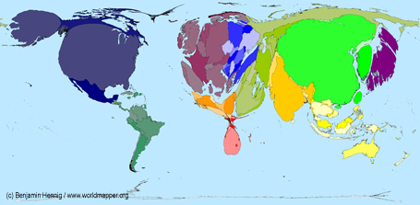
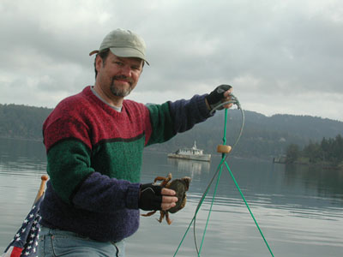

How I Became a Geographer
I love maps!
CO2 Output
www.viewsoftheworld.net
I can tolerate computers
I love the outdoors!
Sailing and Crabbing in the San Juan Islands

Slide 3
Jim’s Classes
Fall:
  Geo 565: Geographic Information Systems and Science (Intro for graduate students)
Winter:
  Geo 599: GIS Programming in Python
  Geo 580: Advanced GIS Applications
Spring:
  Geo 465: Geographic Information Systems and Science (Intro for undergraduate students)
  Geo 599: Big Data and Spatial Modeling

Slide 4
Project Deepwater
What are the risk of major impacts – ecologically, economically, and otherwise – for any particular deepwater/ultra-deepwater well project?
SEER (Spatial Environmental Energy Research)
NETL (National Energy Technology Laboratory)
U.S. Dept. of Energy

Slide 5
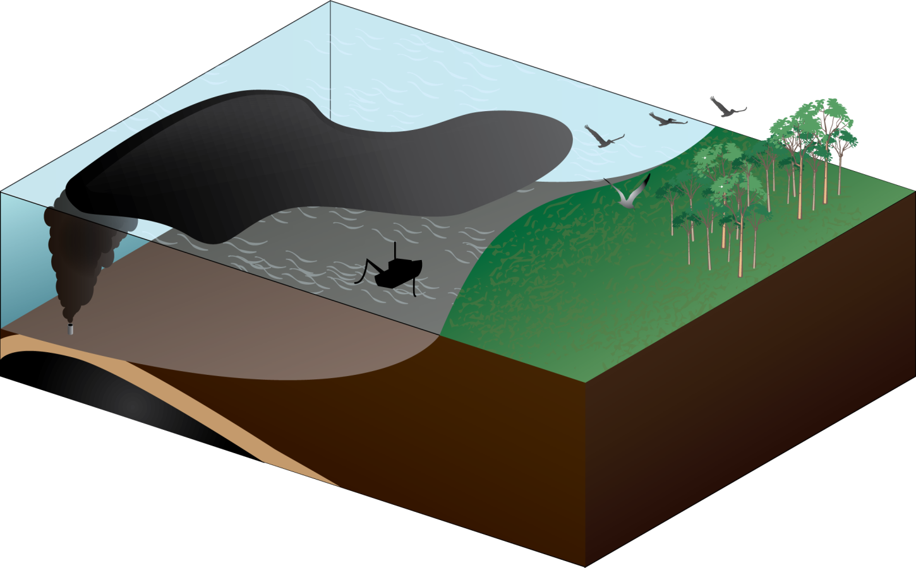
Overall Modeling Problem
Transport
Ecosystem Impacts
Species Ranges
Plume
Human Impacts
Blowout
Reservoir

Slide 6
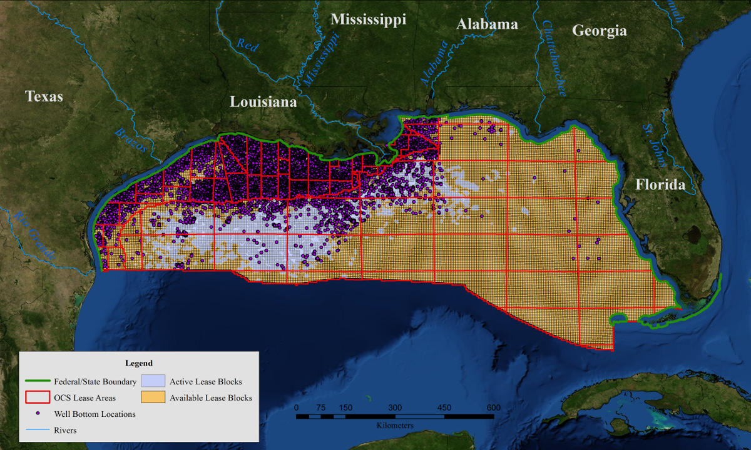
Lease Blocks and Oil Wells
Image of the leave blocks, oil wells, pipelines
Notes:
This map shows the extent of the oil well bottom locations. Some of these are active while others are not. It also shows the lease blocks that are used by the federal government to give permission for companies to drill for oil.

Slide 7
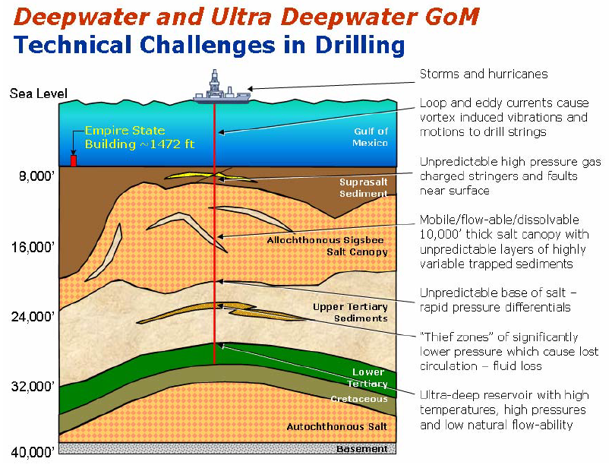
http://www.intsok.com/style/downloads/Chevro-PDF-SPE-Paper.pdf

Slide 8
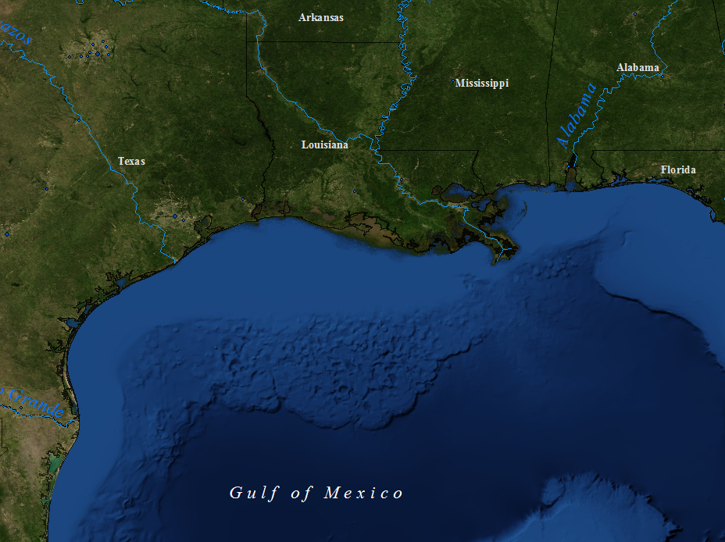
Mississippi-Alabama
Shelf
Texas-Louisiana Shelf
Notes:
- Shelves were formed by millions of years of sediment including organic material. Under pressure and time the organic material decomposed and chagned into hydrocarbons including “crude oil”, a mix of large hydrocarbons, and gas, largely methane.

Slide 9
Cool graphic of subsurface stuff

Slide 10
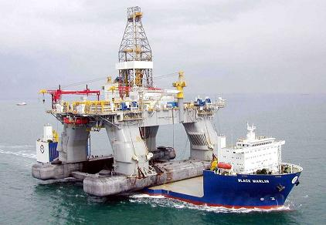
Definitions
Deep-water Horizon
  Oil drilling rig
British Petroleum (BP)
  Company operating the rig (Transocean owned the rig)
Macondo Prospect –
  Lease block in the Gulf
Wikipedia
Notes:
3800 active wells - 30,000 miles of pipelines (Earth’s circumference is 25,000)
5 billion barrels of oil – nearly 20x more than Exxon Valdez

Slide 11
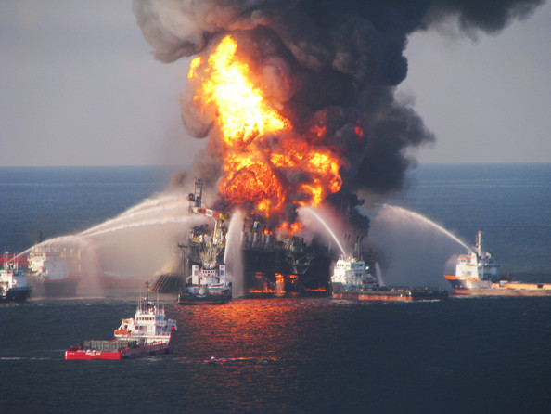
What Happened
April 20th, 2010
  Cement failed to block oil and gas from moving up the “pipe” allowing gas to collect in the rig
  Gas ignited in the rig, the resulting fire eventually caused the rig to sink
  The pipe from the well-head to the rig broke, allowing a mix of crude oil and gas to “spill” into the Gulf of Mexico
Zimbo
Notes:
3800 active wells - 30,000 miles of pipelines (Earth’s circumference is 25,000)
5 billion barrels of oil – nearly 20x more than Exxon Valdez

Slide 12
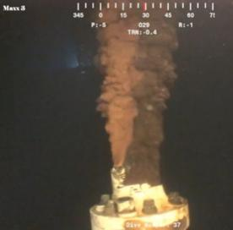
What Happened
As the pipe sank, it broke at the wellhead on the ocean floor
All attempts at stopping the leak failed until it was sealed with mud and then cement
4.9 million barrels of “oil” leaked into the Gulf
Stopped on August 4th
oilspillhub.org
Notes:
Second largest oil spill (Iraq war largest)

Slide 13
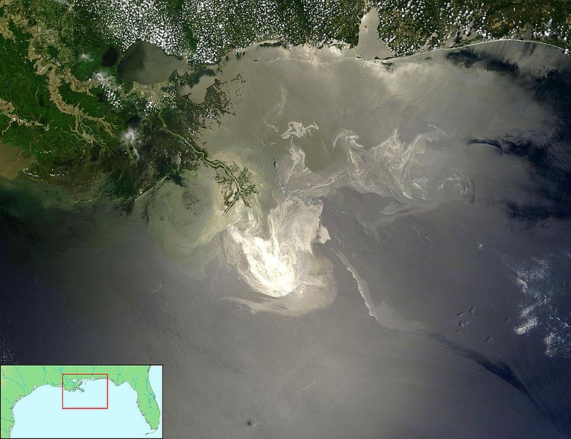
Notes:
This is one of many satellite images of the oil spill. The spill did stayed within the gulf and deposited oil along the northern coast and on the bottom of the gulf.

Slide 14
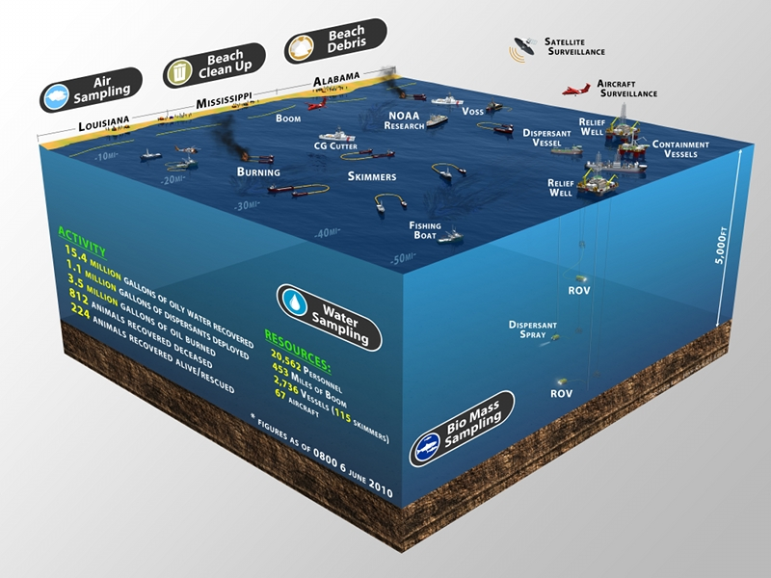
Federal Deep-water Response Team
Notes:
The efforts to cap the well, recover oil, and protect natural areas, and rescue animals were at an unprecedented level.

Slide 15
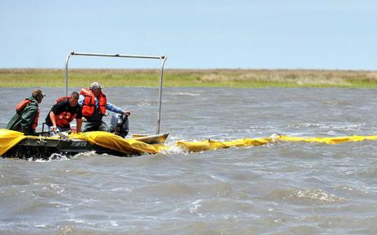
Extent of the Event
Deaths (at least):
  11 people
  2,263 birds
  18 turtles
  4 marine mammals
Involved:
  20,562 people
  2,736 vessels
  67 aircraft
  453 miles of booms
Rescues:
  2,079 birds
  456 sea turtles
  2 marine mammals
Fishermen hired to deploy booms
bp.com, restorethegulf.gov
telegraph.co.u
Notes:
During the incident, the U.S. Fish & Wildlife Service reported 2,303 birds dead and visibly oiled, 18 turtles dead and visibly oiled, and 10 marine mammals dead and visibly oiled.
As part of the response, 2,086 birds, 456 sea turtles, and two marine mammals, all of which were visibly oiled, were rescued and cared for, and in most cases, released.
At its peak, four bird rehabilitation centres, three bird stabilization centres and seven marine mammal and sea turtle rehabilitation centres were opened in strategic locations along the coast, supported by dozens of response teams and hundreds of trained wildlife rescue and rehabilitation professionals.

Slide 16
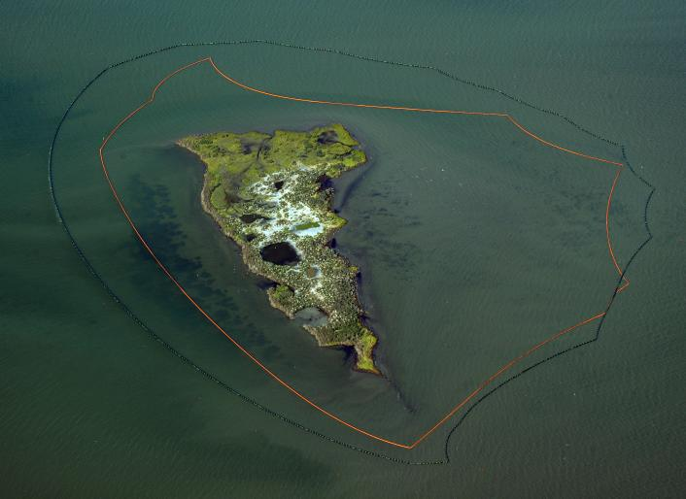
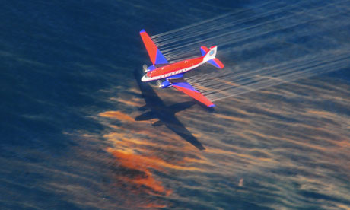
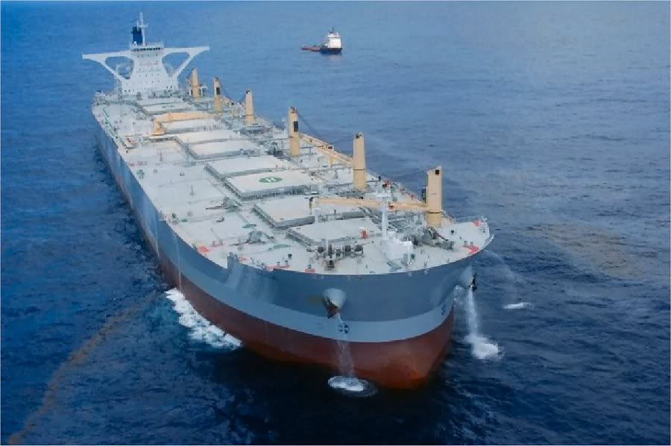
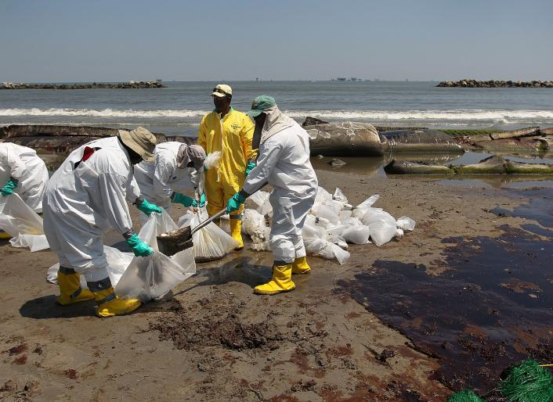
Guardian
Dispersants
Booms around New Harbor Island
www.oil-electric.com
Notes:
Cleanup Crew
A BP cleanup crew shovels oil from a beach at Port Fourchon, La., on May 24. (Photo by John Moore/Getty Images)
“The Whale” a ship modified to siphon oil operating at the Gulf spill
Plane dropping dispersants on the spill
US Navy surrounded New Harbor Island with booms

Slide 17
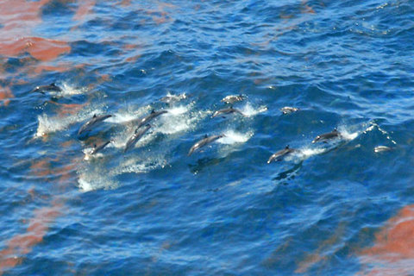
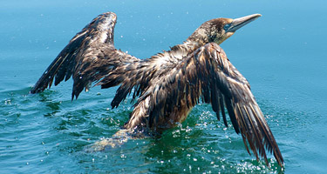
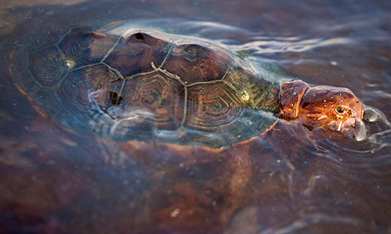
Impacts
Impacts:
  Marshlands: Birds, shellfish, grasses
  Open water: shell fish, fish, marine mammals, turtles
NOAA
www.bp.com
Lee Celano/reuters
Notes:
Most of the impacts in the new are short-term
http://www.bp.com/sectiongenericarticle800.do?categoryId=9036586&contentId=7067607
sea turtle covered in oil from the Deepwater Horizon disaster Photograph: Lee Celano/reuters

Slide 18
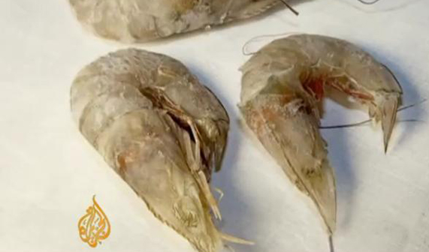
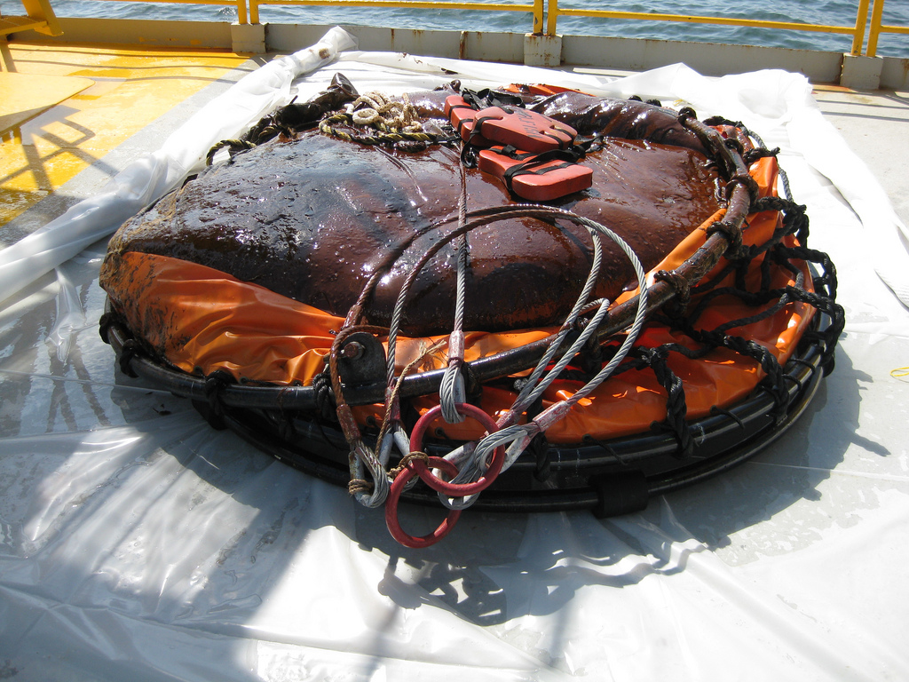
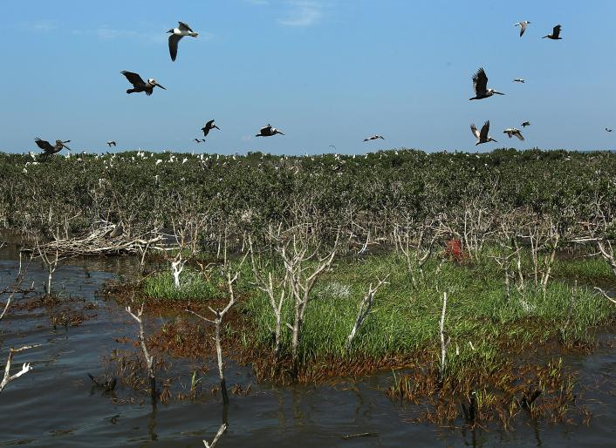
Long-Term Impacts?
Marshlands
Tar-balls on the ocean floor
Mutant animals?
YouTube
US Coast Guard
Notes:
Oil stains line an island in the Barataria Bay on Louisiana's Gulf Coast, on May 24. The island is home to thousands of birds including brown pelicans, egrets and roseate spoonbills. (Photo by John Moore/Getty Images)
- One ton tar ball brought up by the US Coast Guard

Slide 19
Federal Oil Spill Commission Final Report
“Scientific understanding of environmental conditions in sensitive environments in deep Gulf waters, along the region’s coastal habitats, and in areas proposed for more drilling, such as the Arctic, is inadequate. The same is true of the human and natural impacts of oil spills.”

Slide 20
Spatial Environmental Energy Research
SEER Lab:
  Collaboration between DOE’s National Energy Technology Laboratory, Oregon State University, and other organizations
Collect, integrate, make available:
  Data for researching risks and impacts of energy exploration and production
Model potential oil spills and extents
Model impacts on target species and economies
  Shrimp, shellfish
  Turtles, birds, marine mammals
  Marsh vegetation
  And people!
Notes:
There is a wide variety of data available but scattered across a large number of federal, state, and commercial organizations. We’ll be brining key datasets together, integrating them together, and making them available in standard formats.
Working with DOE

Slide 21
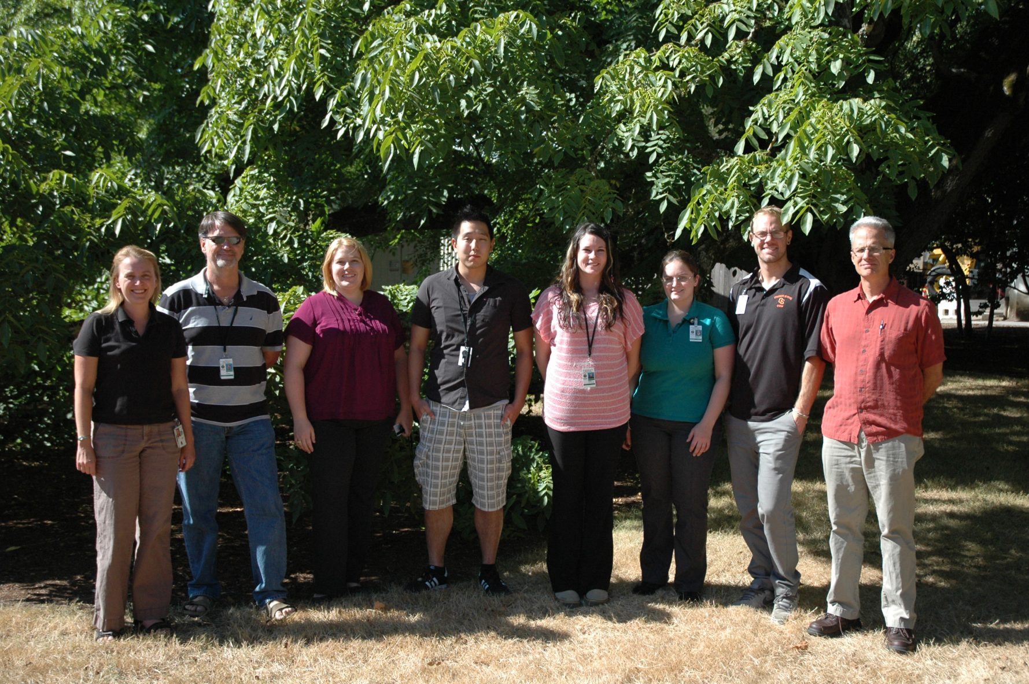
Spatial Environmental Energy Lab

Slide 22
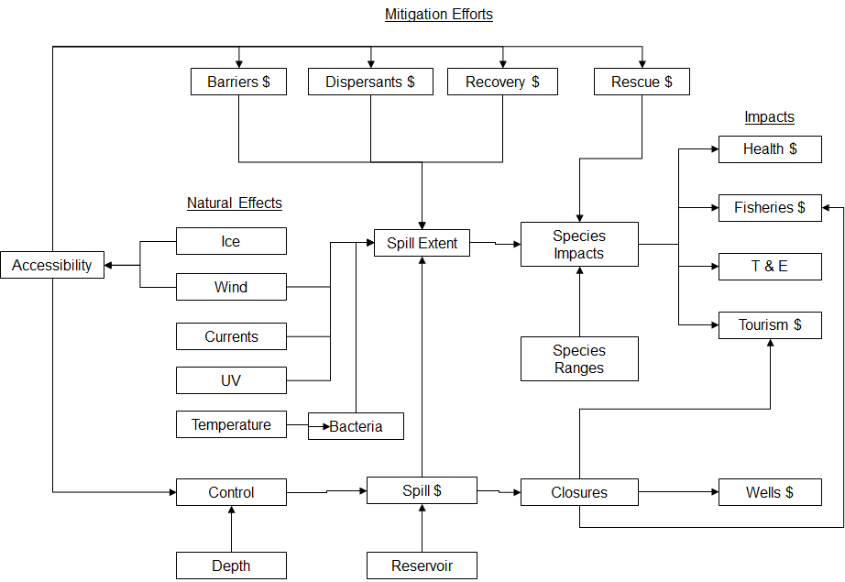

Slide 23
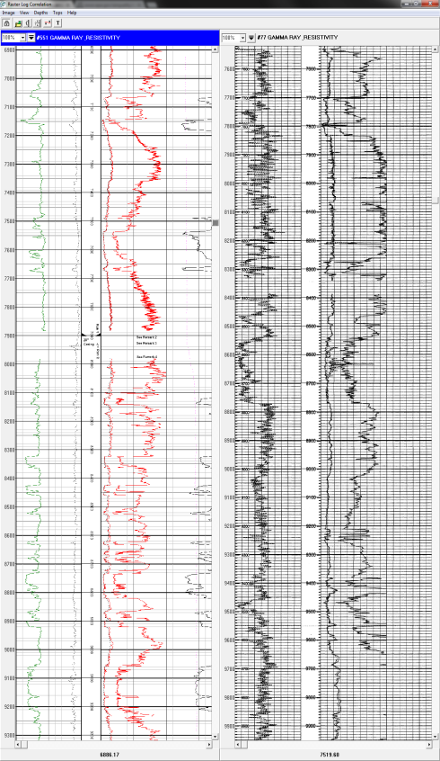
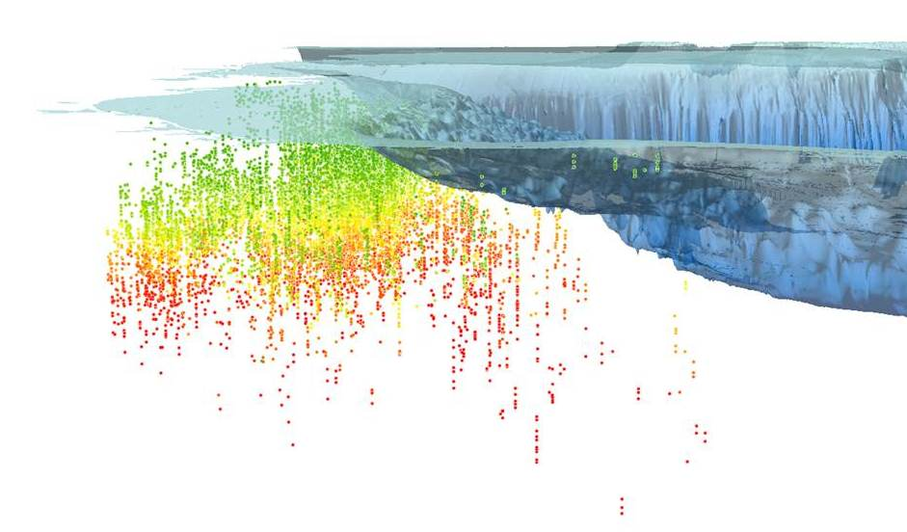
GOM Subsurface Data
Structural components
  Dip
  Fault maps
  Fracture density maps
Oil/water contact location
Gas/oil contact location
GOR
Water Saturation
Formation
  Structural depth (TVD), depth to top of Gross Interval
  Structural depth (TVD), depth to top of Net (= pay) Interval
  Gross Interval thickness
  Net Interval thickness
  Average porosity of Gross Interval
  Average porosity of Net Interval
  Gross Interval permeability (where available)
  Net Interval permeability (horizontal/vertical)
  Composition information
Temperature gradient or measurements
Pressure gradient or measurements
Pore-filling media
  Saturations (oil, gas, water, hydrate)
Completion length (full or partial penetration of well (TD of well), skin)
?
N
E
Initial Pressure PSI
295 24051
Well and discovery information
Trap information
Play name and number
Play age
Hydrocarbon type and reservoir type
Water depth
Proved and unproved resource estimates (oil/gas/BOE)
Structural depth to given interval
Net thickness
Total area and volume
Drive type
Average porosity
Average permeability
Water saturation
Pressure gradient and initial pressure
Temperature gradient and initial temperature
Gas-Oil ratio and produced GOR
Proportion Oil
Oil API gravity
Oil/Gas formation volume factors
Reservoir count in each sand
Depth of water column (bathymetric data)-
for use calculating hydrostatic pressure
Bathymetry Ft
0 -26640
Multiple parameters
Multiple formations and lithologies
Information available for sands (BSEE)
Other information from well logs

Slide 24
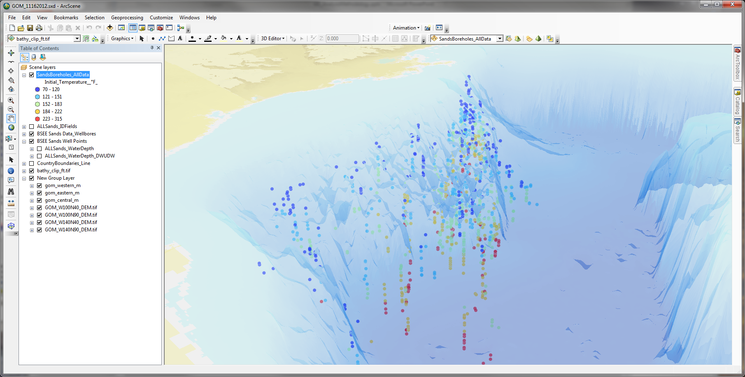
Filling the Gaps
In order to model reservoir characteristics for the entire Gulf, we need to interpolate key characteristics across a large spatial extent (2D and 3D)

Slide 25
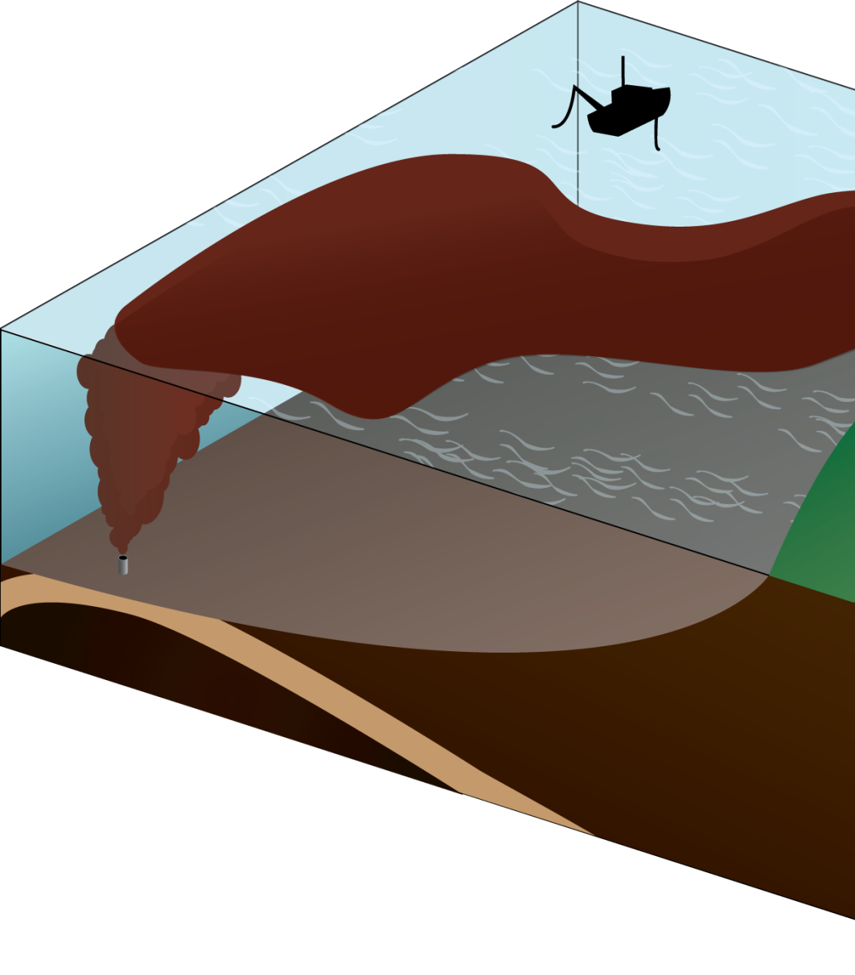
The Blowout/Spill Model
3-major modeling phases:
  Plume/Jet model (control-volumes)
  Conversion to particles/“slicklets”
  Transport model for particles with weathering processes

Slide 26
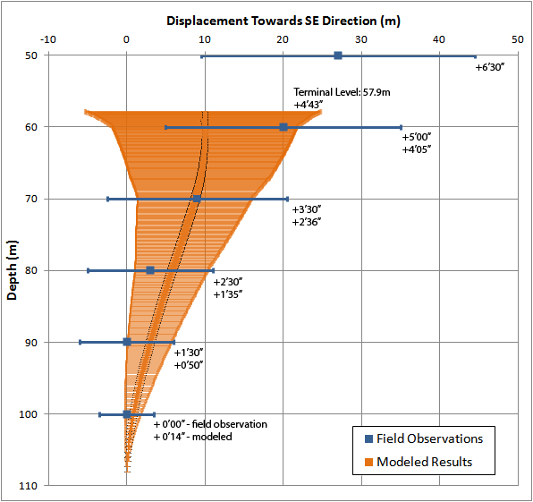
Results
  Good agreement at
  terminal level
  Advection not yet
  implemented causing
  discrepancy in
  displacement
  Early underestimation
  of size and rise
  velocity

Slide 27
Conversion To Parcels/Particles
Intermediary between control-volume based plume model to parcel-based transport model
Use of an offset, concentration centroid to create probability density surface
Placing parcels along rings of constant value and distribute masses and droplet-sizes accordingly
+
●
●

Slide 28
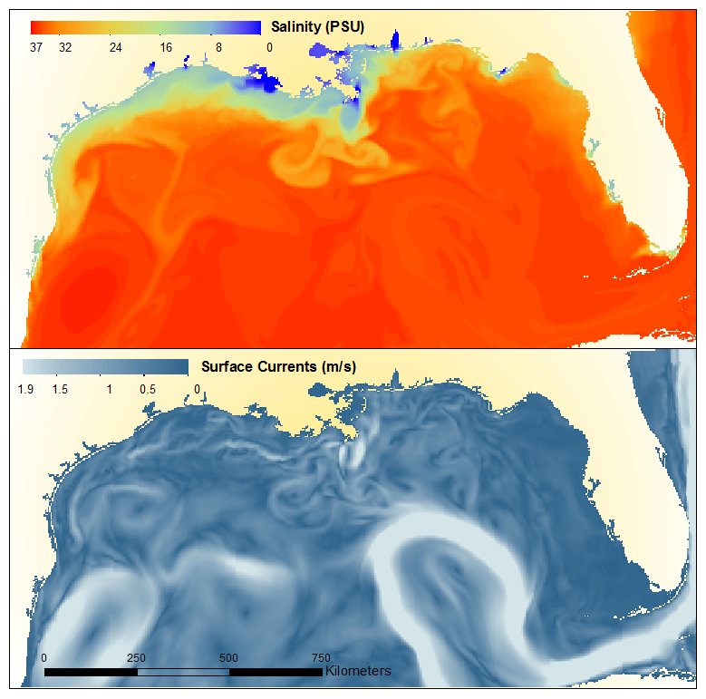
Hydrodynamic Models

Slide 29
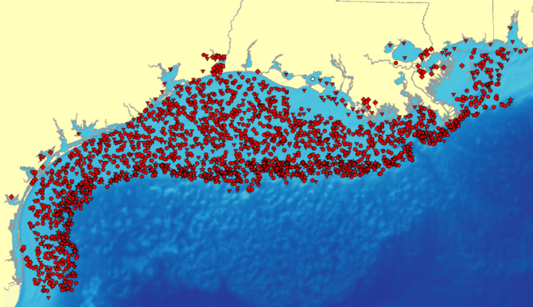
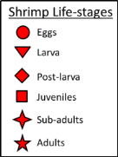
Ecosystem Impacts
Five species of focus in Gulf of Mexico that comprise roughly 70% of fisheries production
Population model for brown shrimp in development
Initial Modeled Brown Shrimp Distribution
Gulf of Mexico top commercial species by value (1991-2010 annual average)
Brown shrimp | $205,000,000
White shrimp | $167,000,000
Gulf menhaden | $60,000,000
Eastern Oyster | $51,000,000
Blue crab | $41,000,000

Slide 30
Species Modeling Overview
Define the problem
Understand the life history of the species
Collect data (species and environmental)
Analyze data
  What is the uncertainty in the data?
Go back to 1 if needed
Build model(s)
Evaluate model(s)
Publish results (including uncertainty)

Slide 31
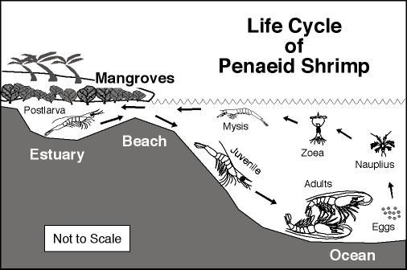
Shrimp Lifecycle
oceanworld.tamu.edu

Slide 33
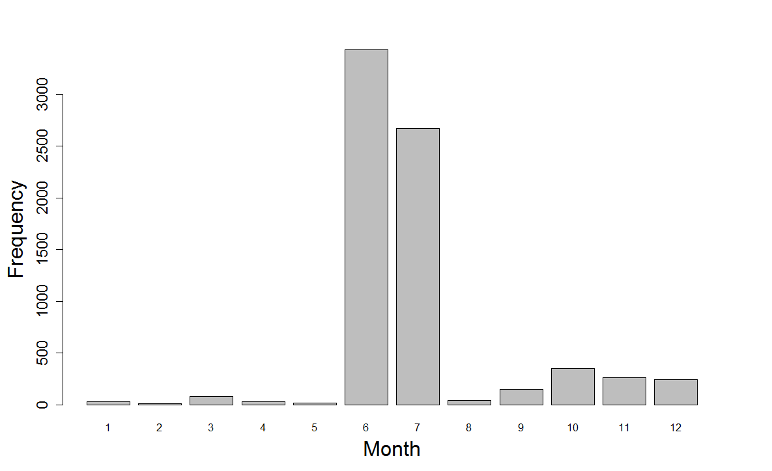
Brown shrimp sample frequency in the open Gulf (1983-2011)
Seasonal assessment for the oceanic survey is not possible

Slide 34
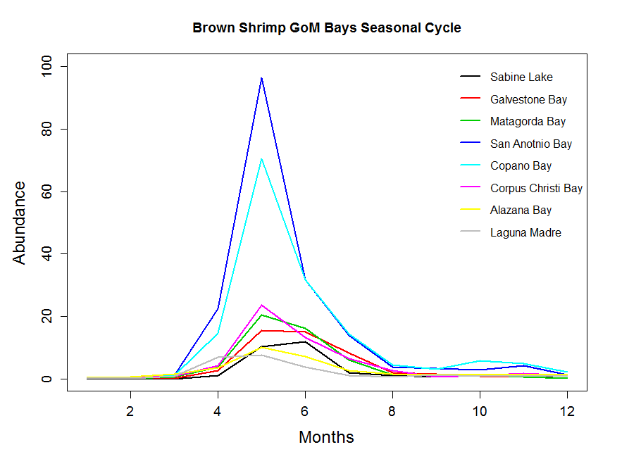
Brown shrimp abundance in bays
Abundance = “catch per hour”
The abundance is higher during months May and Jun for all the bays in the GoM.
Notes:
- Sample frequency for bays is flat

Slide 35
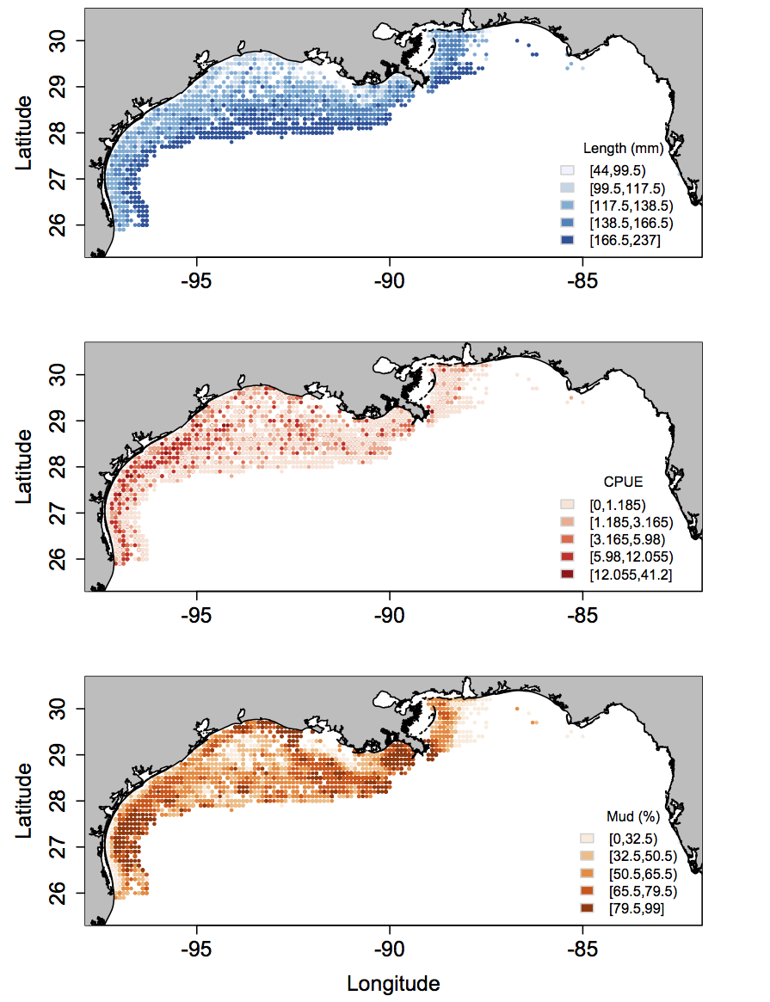
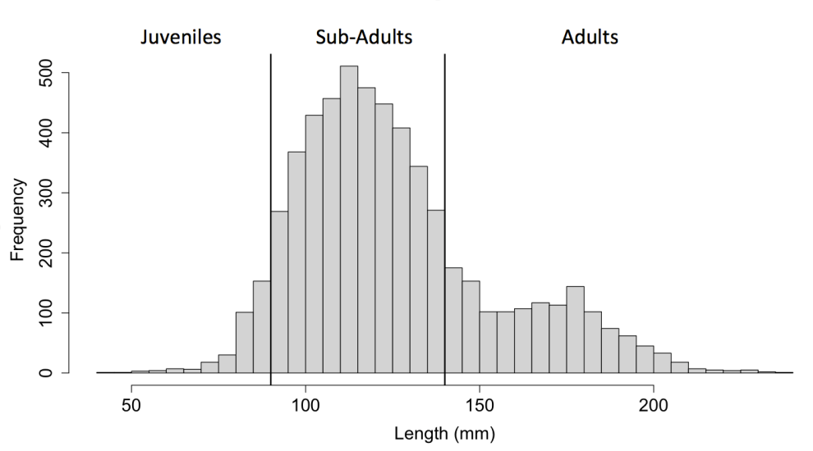
Brown shrimp, length, CPUE, and mud percentage in the GoM
Length: Most of the adults are located far from shore.
CPUE: Abundance is apparently higher close to the estuaries in the west side of the GOM and where the mud percentage is higher.
Size class histogram
Notes:
Just plots of the data

Slide 36
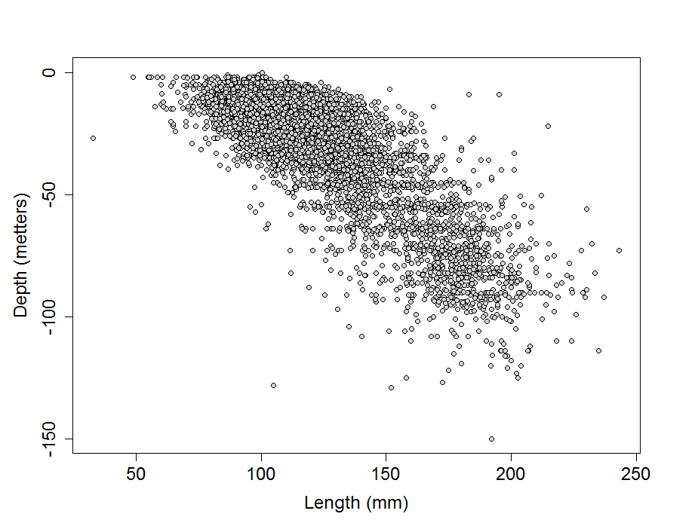
Brown shrimp size at sample depth (SEAMAP)

Slide 37
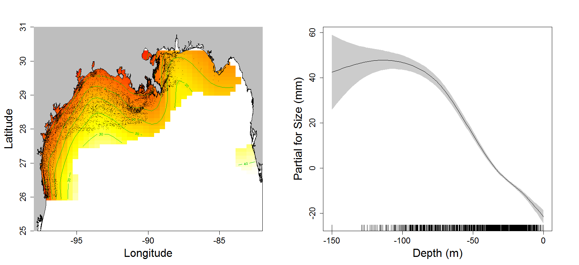
GAM for size vs sample depth
Formula:
Size (mm) = s(Longitude, Latitude, bs='ts', k=50) + s(SampleDepth, bs='ts’)
R-sq.(adj) = 0.76 Deviance explained = 76.4%
P-value < 0.005
n = 5675

Slide 38
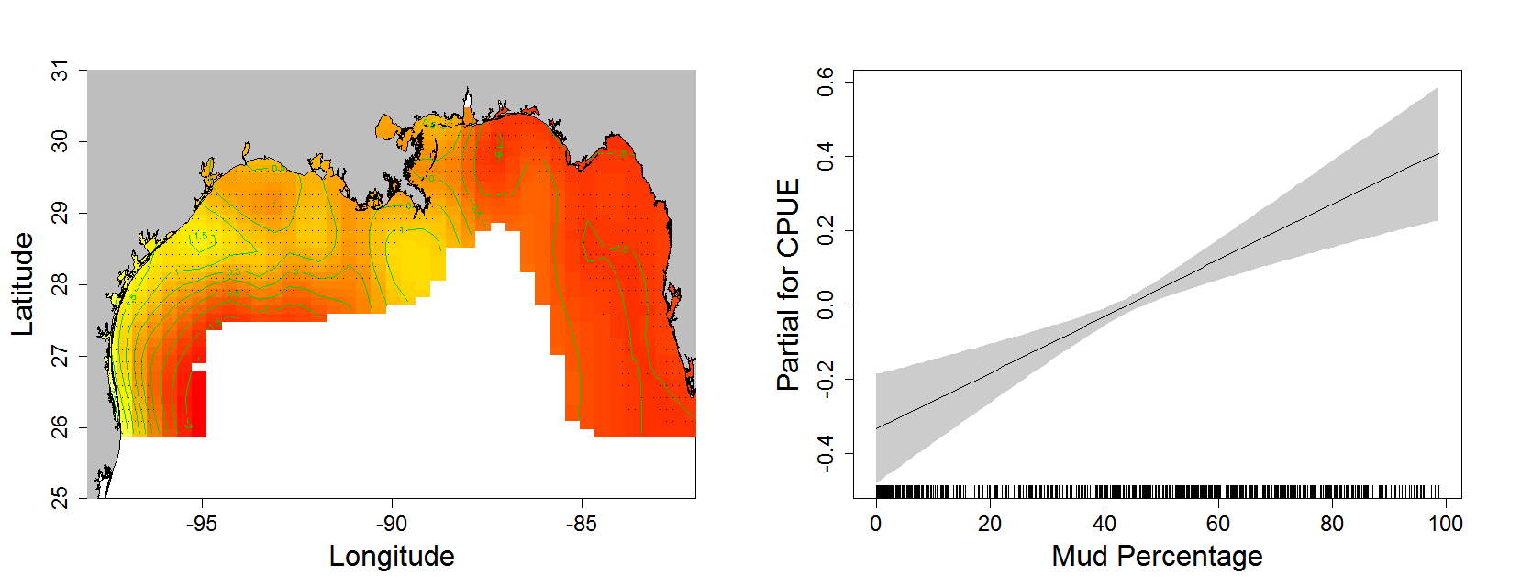
GAM for brown shrimp CPUE vs Mud
Formula:
Log(CPUE) = s(Longitude, Latitude, bs='ts', k=50) + s(MUD, bs='ts’)
The model just works for average CPUE within all years (1983-2011)
R-sq.(adj) = 0.7 Deviance explained = 71.9%
P-value < 0.005
n = 691

Slide 39
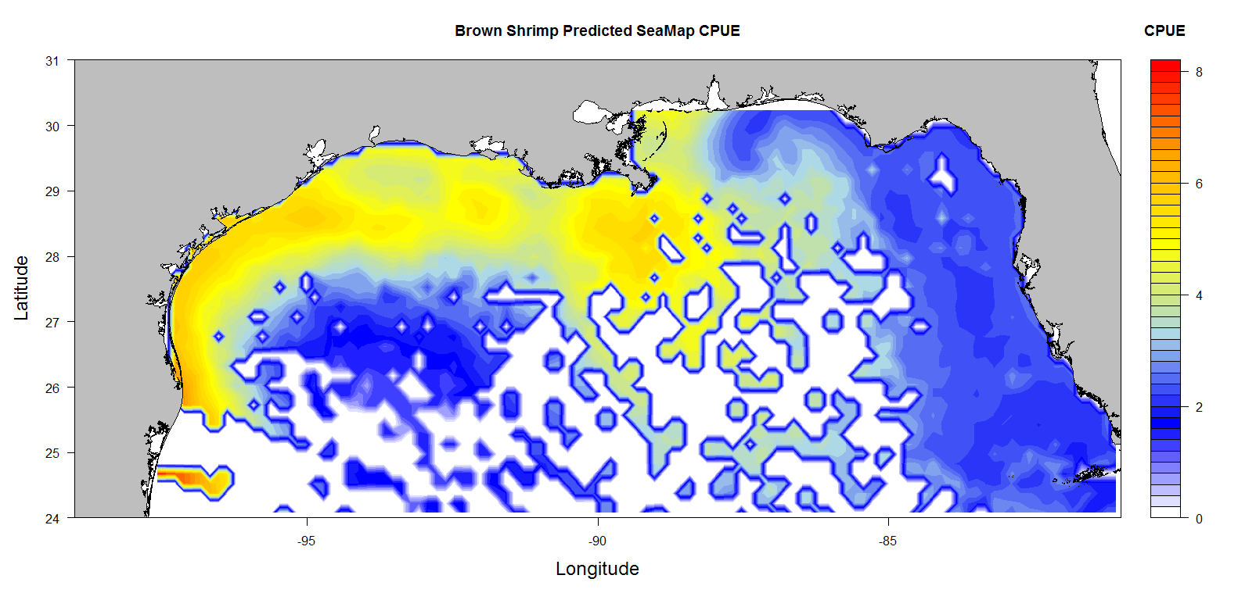
Prediction from the mud GAM
Prediction made using the mud percentage interpolated by IDW for the GoM.
White spaces represent no mud values available (NA)
Notes:
CPUE against mud

Slide 40
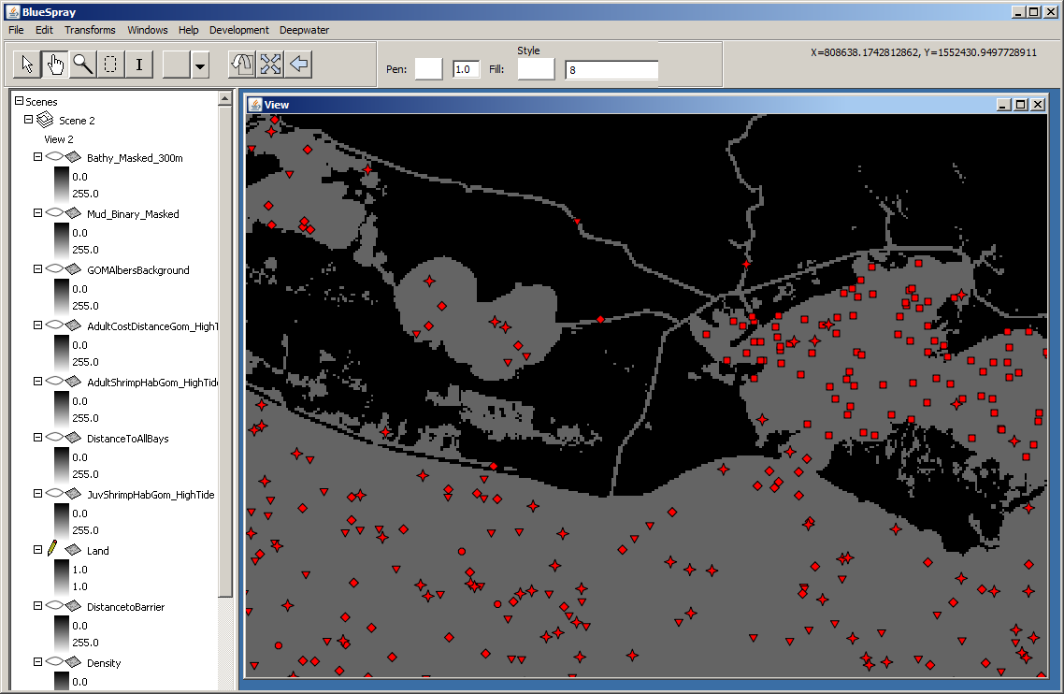
Shrimp Model – Initial State
Picture of shrimp model

Slide 41
Modeling Challenges
Combinatorial:
  Spatial resolution: Canals < 30 meters
  Spatial Extent: 1500 kilometers
  Time step: 6 hours
  Time duration: 1 year to 10 years?
  Number of shrimp groups: 10,000?

Slide 42
Solution?
300 meter resolution
  Maintaining open canals
  Additional layers for percent water cover
Keep model really fast!

Slide 43
Future Research & Monitoring
Realistic Movement

Slide 44
BlueSpray
GIS Application for spatial transform development, modeling, processing, and cartography
Java-based:
  MS-Windows, Mac, Linux, Unix
  Fast
  Robust (or will be)
Currently in beta
Available at www.schoonerturtles.com
Email Jim for the passcode

Slide 45

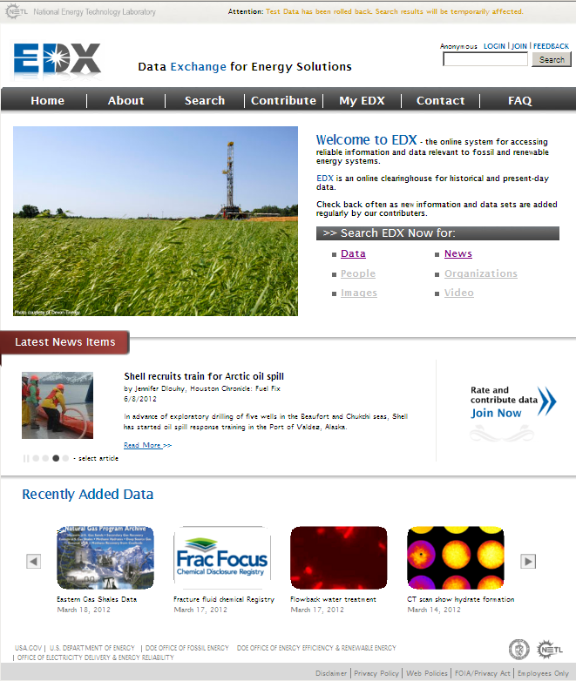
Data Exchange for Energy Solutions
  R&D coordination & collaboration tool
  Share information across networks
  Rapid access through one site
  Online access for historical data
  Venue for newly released datasets
  Security, database design, and structure leverage DHS system
  Built to accommodate both open access and restricted access data
  Role-based security allows for groups or “communities” within the system
  Future FY13 roll outs will incorporate spatial/mapping tools, displays and other opportunities
Designed for:
  Fossil & renewable energy researchers
  Policy makers
  General public
More information on EDX: http://www.netl.doe.gov/publications/factsheets/rd/R%26D184%20.pdf
Now available at: https://edx1.netl.doe.gov

Slide 46
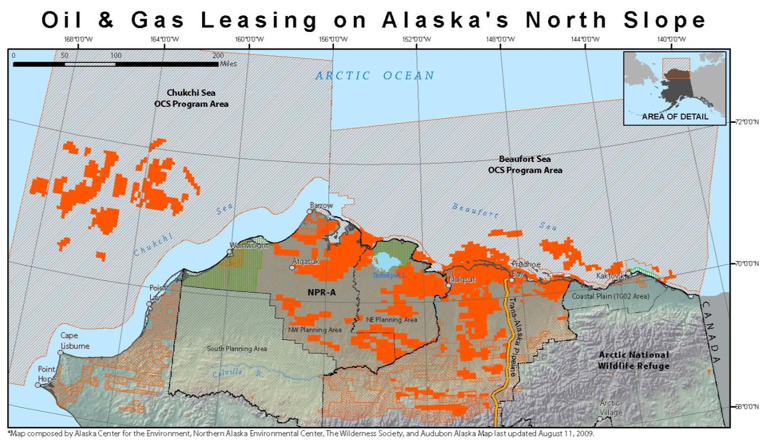
Future Research & Monitoring

Slide 47
Arctic Drilling
Dynamics of oil and sea-ice
Slower decomposition rates
Sensitive ecosystems
Difficulty of response times, ability, and logistics

Slide 48



Acknowledgments
Oregon State University
National Energy Technology Laboratory
U.S. Department of Energy
Background Image Credits (left to right)
  Los Alamos National Laboratory
  National Oceanic and Atmospheric Administration
  U.S. Senate Committee on Environment and Public Works
Notes:
Final Reports:
http://ccrm.berkeley.edu/pdfs_papers/bea_pdfs/DHSGFinalReport-March2011-tag.pdf

Slide 49
Additional slides
Following are potential slides or “pocket slides” to be used if needed.
Citation:
  Graham, J., K. Rose, L. Sim, J. Nelson, K. Van Acker, C. Disenhof, C. Ringo, and J. Bauer. 2012. Learning From Deep Horizon: Connecting The Public, Researchers, And Decision Makers In Risk Assessment And Response To Oil Spills. North America Congress for Conservation Biology.

Slide 50
Spatially Explicit Population Model
Models a population in space and time
Required to:
  Understand the spatial-temporal impacts of an oil spill on shrimp, and to model the recovery
Initial Modeled Brown Shrimp Distribution

Slide 51
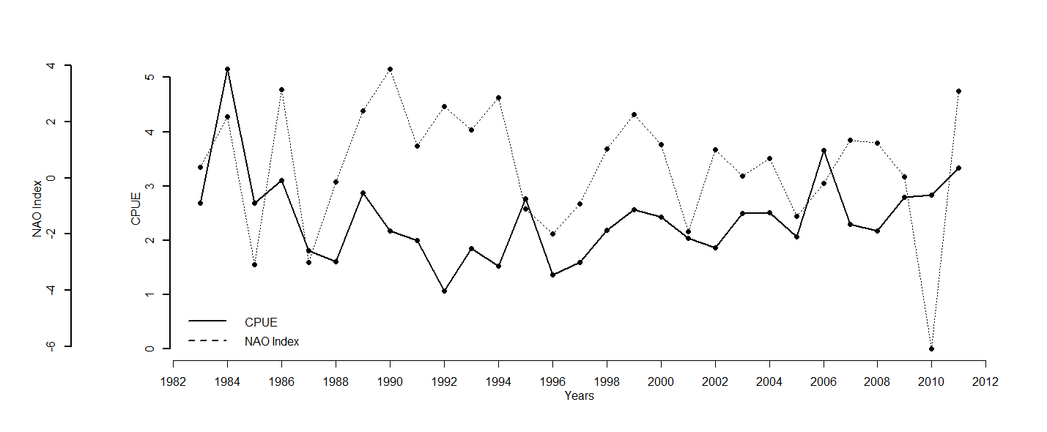
Brown shrimp CPUE and NAO?

Slide 52
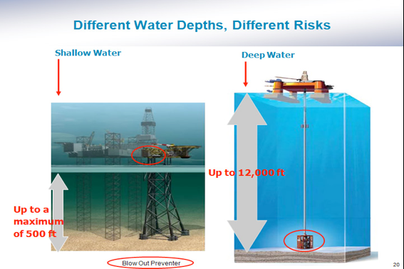

Slide 53
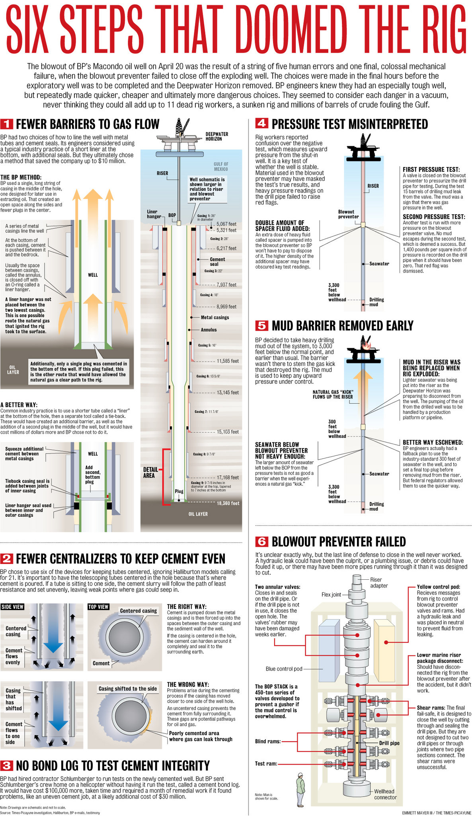
Notes:
http://www.nola.com/news/gulf-oil-spill/index.ssf/2010/09/six_steps_that_doomed_bps_deep.html
This is one of the most concise summaries of the potential cause of the failure.

Slide 54
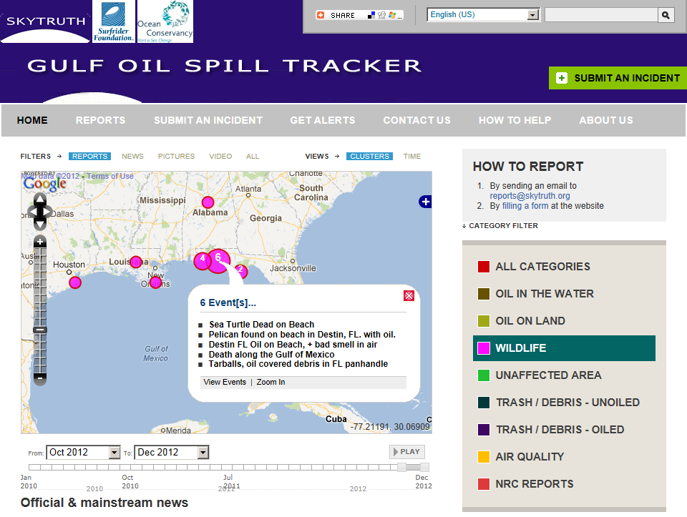

Slide 55
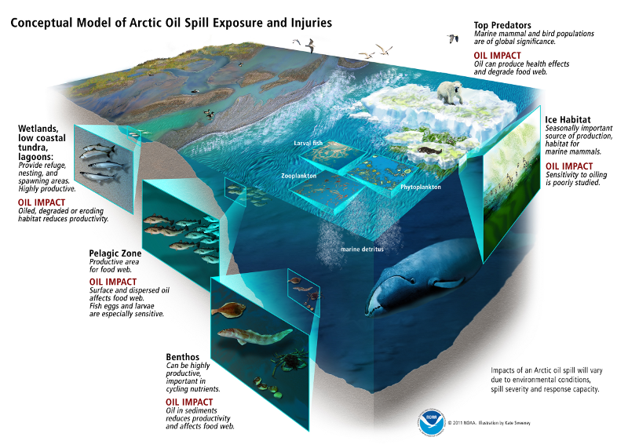

Slide 56
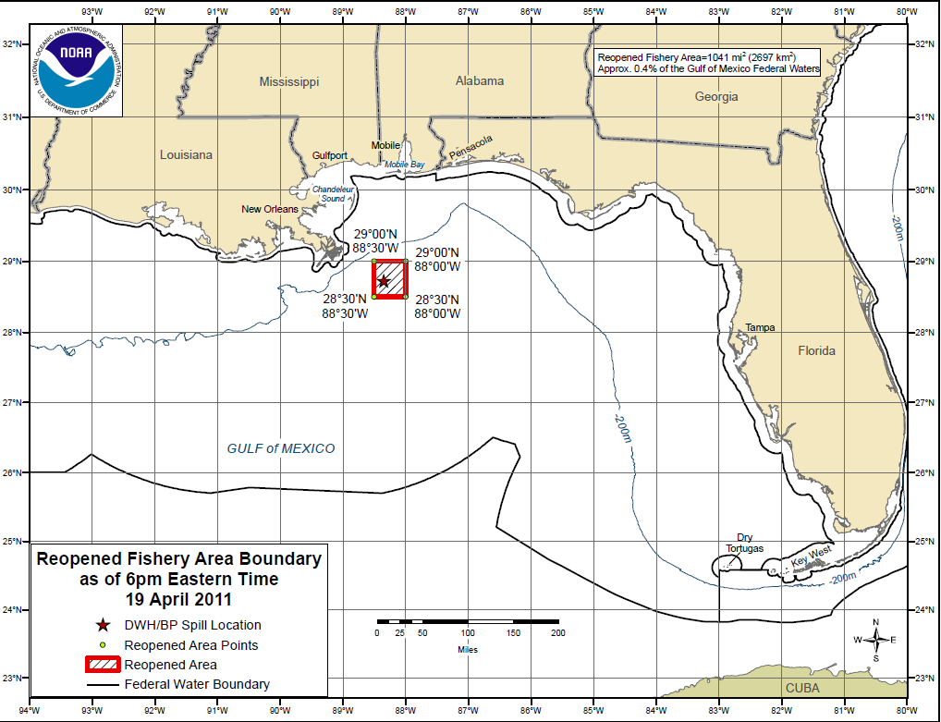

Slide 57

NOAA Fisheries: Office of Protected Resources

Slide 58













Hundreds of Organizations…
Notes:
Surfrider Foundation: Emerald Coast Chapter
Documenting oil on beaches with UV lamps
Huge number of local and volunteer organizations

Slide 59

Organizations Involved
States:
  Alabama
  Louisiana
  Florida
  Texas
  Mississippi
Commercial
Military
Federal:
  NOAA
  NASA
  Dept. of Interior
  Fish & Wildlife Service
  Dept. of Energy
Local:
  Too many to list!

Slide 60
Steps
Research the overall task
What is available? What needs to be done?
Gather data (lots of data)
Develop models
  Species distributions
  Oil spill extent
  Toxicity
  Economic
Model risks & impacts

Slide 61
Integration with Impacts
Overlap Impact Model
  “Staining” of 3d-grid at specified time intervals, determine overlaps with species distributions
  Determination of concentration, but total and by fractions of each distillation cut and estimated average molar mass
Dissolved Oils
  Integrate dissolved oils into flow model to track movement of potentially toxic water masses

Slide 62
Transport & Weathering
Advection from wind, wave, and currents
  Advection-diffusion equation
  Smagorinsky model for horizontal diffusivity
Horizontal diffusion
  Random-walk technique
Spreading
  Initial spreading from gravity-inertial phase ignored as largely spread by plume
  Spread of slick past threshold size will use modified form of conversion model
Dispersion
  As factor in spreading or splitting parcels into sinking droplet clouds
  Delvigne and Sweeney 1988
Evaporation
  Pseudo-components approach by distillation cut
  Daling et al. 1997
Emulsification
  Empirical model of Fingas and Fieldhouse 2003, 2004
Biodegradation
  Significant to long-term fate of oil
  Determines rates at depths
Dissolution
  Insignificant for mass loss but may be significant for toxicity/impacts
Photolysis
  May be very significant to toxicity/impacts on long time-scales

Slide 63
Intertidal Zones & Estuaries
Hydrodynamic handler capable of switching to high-resolution model outputs in estuaries
  Pre-defined high-resolution zones by distance to coast and coastline-complexity
Tidal station data and high-resolution DEMs to create intertidal model
Beaching and re-entrainment of oil at intertidal zones (with sedimentation)

Slide 64


Slide 65

Notes:
Source: http://www.nmfs.noaa.gov/pr/health/mmume/cetacean_gulfofmexico2010.htm#map

Slide 66


Shrimp Population Modeling
Adults
Juveniles
Post-Larva
Eggs

